Slide 1

TEAM 7 SELLER MANAGEMENT SYSTEM

Slide 2
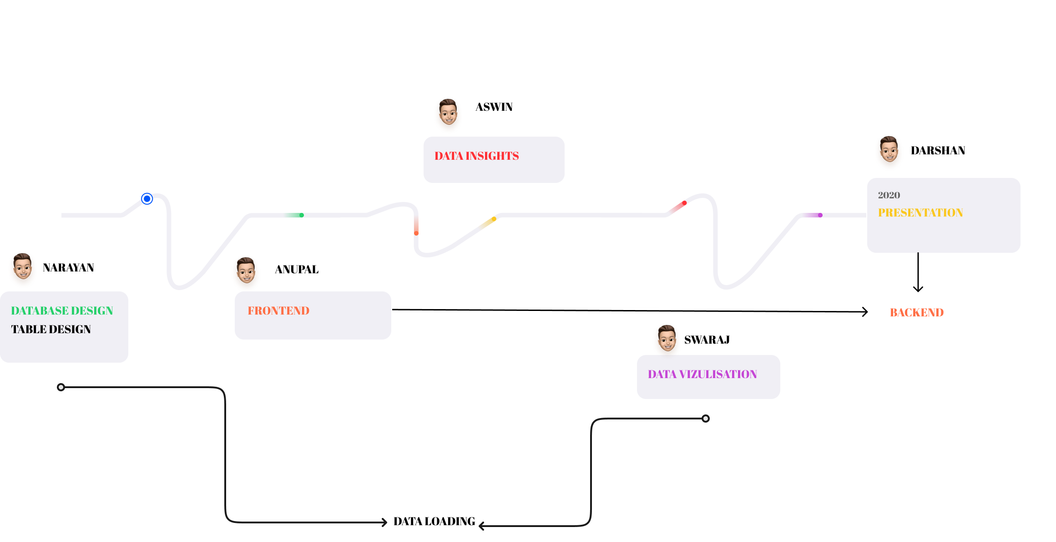
WORK FLOW

Slide 3

Problem Statement
Product Availability
Product Insights
Storage Management

Slide 4
Product Description
Our product focuses on the seller part which helps the seller to analyze their products selling percentage and other insights which are profitable to the seller.

Slide 5


Proposed System
LOG IN
SELLER ID
PASSWORD
PRODUCT LIST
PRODUCT NAME
SALES REPORT ANALYSIS

Slide 6
tools
PYTHON
PYQT 5 – USER INTERFACE
MATPLOTLIB - VISUALIZATION
SQLite
DATABASE
GitHub

Slide 7

Challenges
Faced

